Slide 1
YOUR NEXT MOVE
WORKER
INFORMATION
Notes:
Welcome to the Fox Valley Work Force Development Worker Information Presentation.
The goal of this presentation is to provide information and resources to prepare unemployed workers to Re-Enter the Workforce

Slide 2
WHAT YOU WILL TODAY
WIOA DW Services
On-Line Job Center Services
Registering on Job Center of Wisconsin (JCW)
Skill Explorer
Navigating Your UI Claim
Prior to Your Layoff Date
Healthcare Coverage Options
Community Resources
Education Resources
Career Planner Information
Next Steps
Notes:
Today we will be learning about the following items:

Slide 3
WIOA DW SERVICES
Resume Development
Cover Letter Development
Mock Interviews
Support Services
Career Assessment and Planning
Tuition/Book Assistance
Support Services
Job Search
Education & Training
Notes:
You are Eligible for Dislocated Worker Services
The WIOA Dislocated Worker Program provides career services & resources, workforce readiness & training services for Laid-Off Workers through the American Job Center System and the Public Workforce System
There are two tracks of assistance: Job Search and Education and Training

Slide 4
ON-LINE JOB CENTER SERVICES
Resume Development
Career Planning
Workshops
Networking
Job Searching with technology
Interviewing
Your workplace skills
JobCenterOfWisconsin.com
Notes:
Using the Job Center of Wisconsin Website you can access resources to
Create a resume
Find help planning your Career
Watch a Workshop like
Networking
Job Searching with Technology
Resume & Job Application
Interviewing
Your Workplace Skills

Slide 5
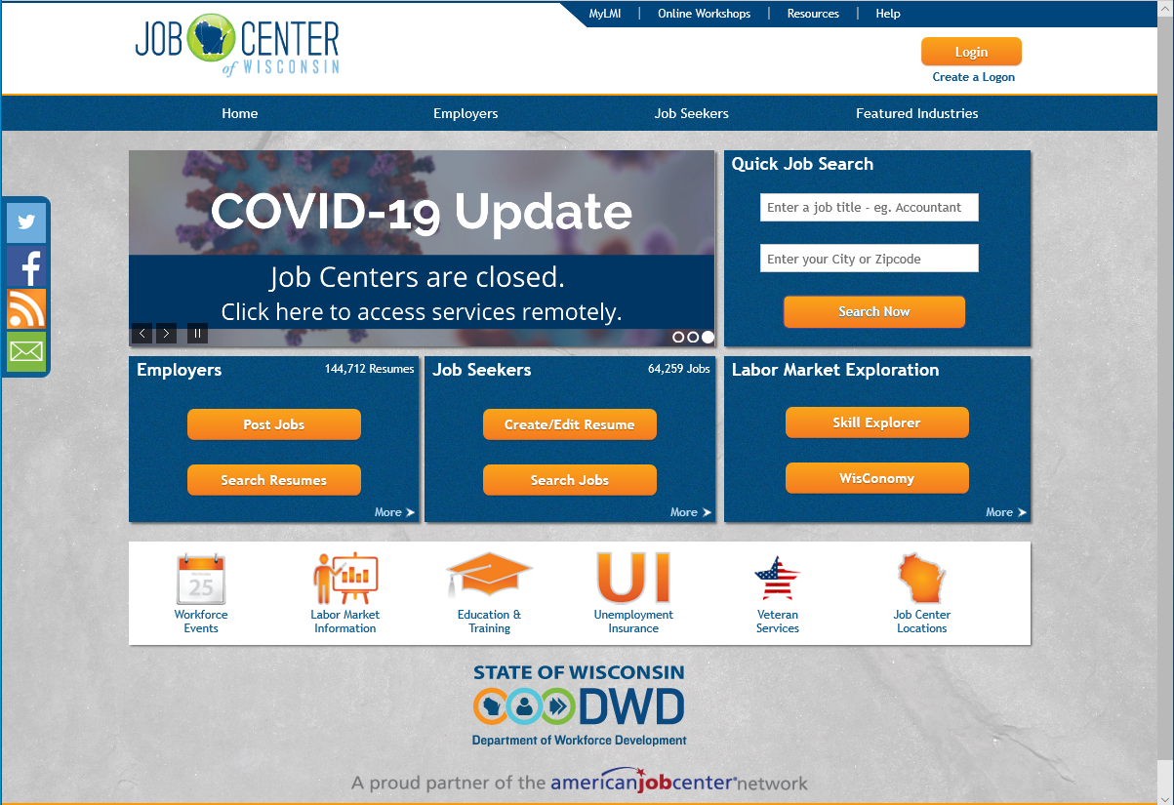
REGISTERING ON JOB CENTER OF WISCONSIN
Job Center of Wisconsin
Notes:
jobcenterofwisconsin.com is an on-line 24/7 informational website that helps individuals plan and move forward in their unemployment claims, job search, and careers. It also serves as a resource to connect individuals to various resources through-out the state of Wisconsin
You can click on the words Registering on Job Center of Wisconsin in the title of this slide and it will take you to a detailed presentation on how to register for an account. The user id and password will be used for both job search and unemployment purposes
Registration is required
To receive Unemployment Insurance claims and weekly filing
To use on-line services like job search and resume development

Slide 6
SKILL EXPLORER
Re-Employment and Job Search
Notes:
Skill Explorer is a job search tool that goes beyond titles to find opportunities that match the skills and training you have – but in career fields you may not have considered. It shows you more options and those options mean a better chance of finding a job
Click on the words Skill Explorer in the Title of this slide and it will take you directly to the Skill Explorer website where you can start your job search with just a few key words.

Slide 7
APPLYING FOR UI
Navigating your Unemployment Insurance Claim
Notes:
When you are out of work you’ll need to apply for unemployment benefits before you can begin filing a weekly claim
Click on the words Applying for UI in the Title of this slide and it will take you to a video presentation on how to apply for your benefits. You will use the same user name and password that you created for the jobcenterofwisconsin.com website
Please make sure you have the documents asked for in the video

Slide 8
PRIOR TO YOUR LAYOFF DATE
Review Household Budget
Research Community Resources
Research Education and Training Resources
Research Options for Healthcare Coverage
Notes:
You should review your individual and family budget to see if you can eliminate unnecessary spending. Seek professional assistance if you need additional help
Healthcare Options should be reviewed based on your personal needs in order to keep your costs low
Community Resources are available for your personal needs
Education and Training Resources are available through local partners as well as on-line

Slide 9
HEALTHCARE COVERAGE OPTIONS
Spouse’s Plan
Private Insurance
Or
COBRA
Badger Care Plus
The Market Place
Notes:
Options you may have include:
COBRA is an acronym for Consolidated Omnibus Budget Reconciliation Act, which provides eligible employees and their dependents the option of continued health insurance coverage. COBRA is usually high because you have to pay the entire cost of the insurance not just your monthly premiums
Due to job loss you can usually be added to your spouse’s policy with no penalties
BadgerCare is a public healthcare coverage program for low-income Wisconsin residents.
You can click on the BadgerCare Plus Circle in this slide to check your eligibility
Healthcare.Gov is a health insurance exchange website operated under the United States Affordable Care Act.
You can click on the Market Place Circle in this slide to explore your options
Private healthcare insurance can often be obtained through the same agent you have your car or home insurance policies.
You can use 2-1-1 to look for agents in your local community

Slide 10
COMMUNITY RESOURCES
Financial Information & Service Center
Help with managing your money
through this transition
Assistance with all your personal needs like
Food Pantries, Shelters, or
Counseling Services
Determining Eligibility for Food share
Child Care, Transportation, and
Energy assistance
Notes:
Financial Information & Service Center is available to assist with budgeting and other financial needs.
You can explore the options by click on the FISC icon in this slide
United Way 2-1-1 is a resource to help you access services for personal needs like food, shelter, childcare, and transportation.
You can get more information by clicking the 2-1-1 icon in this slide
Access is a website where you can apply for FoodShare, Childcare, and Family Planning
You can start an application by clicking the Access icon in this slide

Slide 11
EDUCATION RESOURCES
Career Exploration
Enrollment Advisors
Basic Skills Assessments
Short Term Credentials
Campuses in Appleton, Oshkosh,
and Waupaca
Campuses in Beaver Dam, Fond du Lac,
and West Bend
WIOA Eligible Training Programs List
Notes:
Earlier we mentioned the WIOA DW program provides assistance with education you can find more information about local partners who provide education and training by clicking on the icons in this slide
The ETPL icon will take you to the WIOA Eligible Training Programs List. In most cases the education and training program you are interested in will need to be on this list in order to be eligible for WIOA funding
If you are thinking about Education and Training there will be many questions which can be answered by your local WIOA Career Planner
CAUTION: Only individuals enrolled in WIOA and eligible for the program can access benefits such as tuition, books, and other support services
Do NOT commit to pay for any expenses until you have contacted a WIOA Career Planner.

Slide 12
CAREER PLANNER CONTACT INFORMATION
Northern Winnebago (Neenah, Menasha, Appleton and Calumet County)
Donna Janda (920) 968-6373
Lisa MaKarrall (920) 470-2744
Fond du Lac and Southern Winnebago County (Oshkosh area)
Alene Leazer (920) 960-3031
Waupaca, Waushara and Green Lake Counties
Lisa MaKarrall (920) 470-2744
Notes:
WIOA Career Planners can help you determine areas of interest, assess your current skills and help provide direction for your next job
Here you can see the areas served in the Fox Valley Workforce Development Area along with contact information

Slide 13
NEXT STEPS
What do YOU want for YOUR future!
Notes:
Take some time to think about what you want for your future career
Connect to the Resources and Benefits you need to become re-employed
Contact your local WIOA Career Planner to get started on your WIOA Application

